Slide 1
Version Control
Matthew Hess
CS490
2/18/2019

Slide 2
Overview
What is version control?
Creating a repository
Branching overview
Forking overview
Implementation

Slide 3
What is Version control?
Version control is a system that records changes to a file or set of files over time so that you can recall specific versions later.
It allows you to collaborate a system of records with multiple people
It allows you to revert selected files back to a previous state
It allows you to revert the entire project back to a previous state
It allows you to compare changes over time
It allows you to see who last modified something that might be causing a problem, who introduced an issue and when, and more. #STATISTICS

Slide 4
How would you version control?
You all do version control already and you’re probably not realizing it
Copying files and folders from one USB to another
Editing photos:
- Copy photos to an edited folder to keep originals untouched
- Backups
Git is a tool that handles version control
Git is a free and open source distributed version control system
GitHub is the most popular remote registry for your remote Git repositories
Git is not the only tool that handles version control but it is very popular
Git GUI & Git Bash

Slide 5
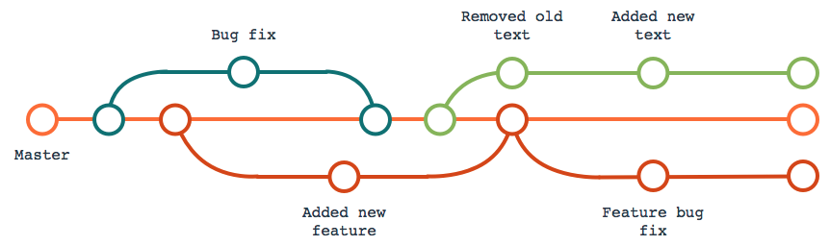
Version Control Branches
Branches are used for separate lines of development, by “branching” we refer to changes off of the main repository’s history
The master branch is the base copy / history of the file directory system, other branches utilize this copy to work off of / with
It is common to develop new features and implementations on a branch other than the Master branch
Any changes made in a branch, i.e. “Bug Fix”, other than main branch (Master) will not effect other branches, i.e. “Added new feature” unless that branch (file directory system) is merged with the base copy of the file system (Master)

Slide 6
Creating a Repository from the command line Way 1
Make repository on Github
mkdir RepositoryName
cd RepositoryName
git config --global user.name matthew9510
git config --global user.email matthew9510@gmail.com
git init // initialize the folder to be a git repository
git remote add origin https://github.com/UserName/RepositoryName.git
"origin" is a shorthand name for the remote repository that a project was originally cloned from.
echo "# GitPresentationRepo" >> README.md
git add README.md
git commit -m "first commit"
git push -u origin master

Slide 7
Creating a Repository from the command line Way 2
Make a git repository online
Open terminal an change directory until you found the directory where you will want this repository to live
“git clone <link to repository>”
Clone is used to target an existing repository and make a copy of it on your local computer
git remote add origin https://github.com/UserName/RepositoryName.git - done for us b/c clone
echo "# GitPresentationRepo" >> README.md
git add README.md
git commit -m "first commit"
git push -u origin master
Show Branching Example

Slide 8
Forking
A fork is a copy of a repository.
Forks are used to either propose changes to someone else's project or to use someone else's project as a starting point for your own idea.
Forking a repository allows you to freely experiment with changes without affecting the original project.

Slide 9
Forking Way 1
Scenario:
Original Code produced by someone else
Caroline and Sarah wanting to make their own version

Slide 10

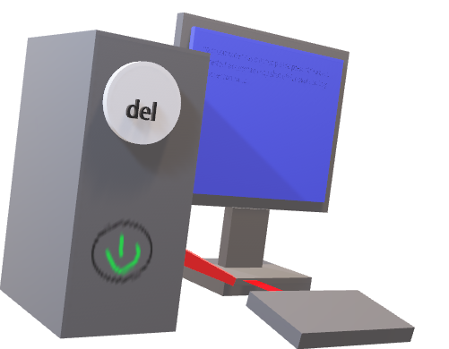




Forking
Jerry’s Recipe Repo On Github
Caroline’s Recipe Repo On Github
Caroline’s Recipe Repo Remote on Local Computer

Slide 11
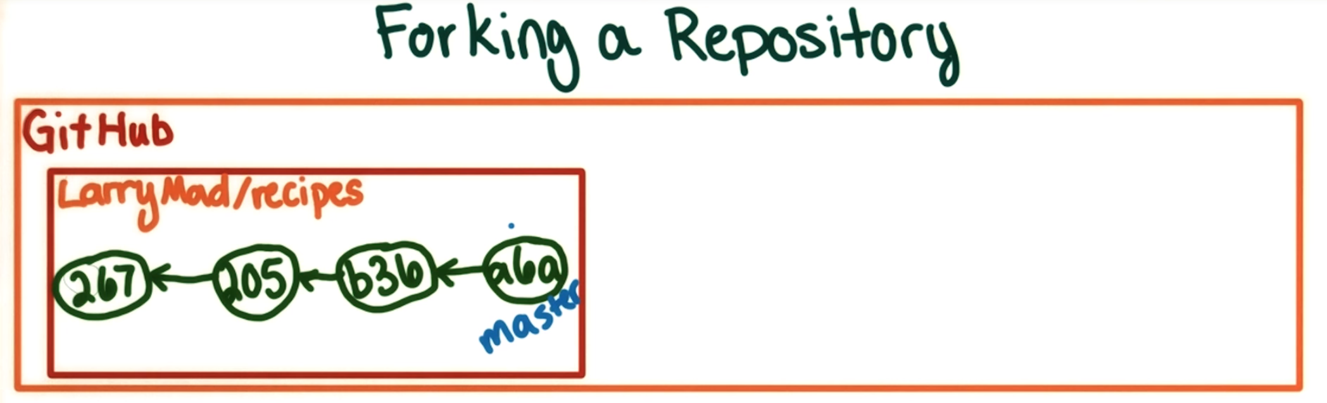

Forking Way 1

Slide 12
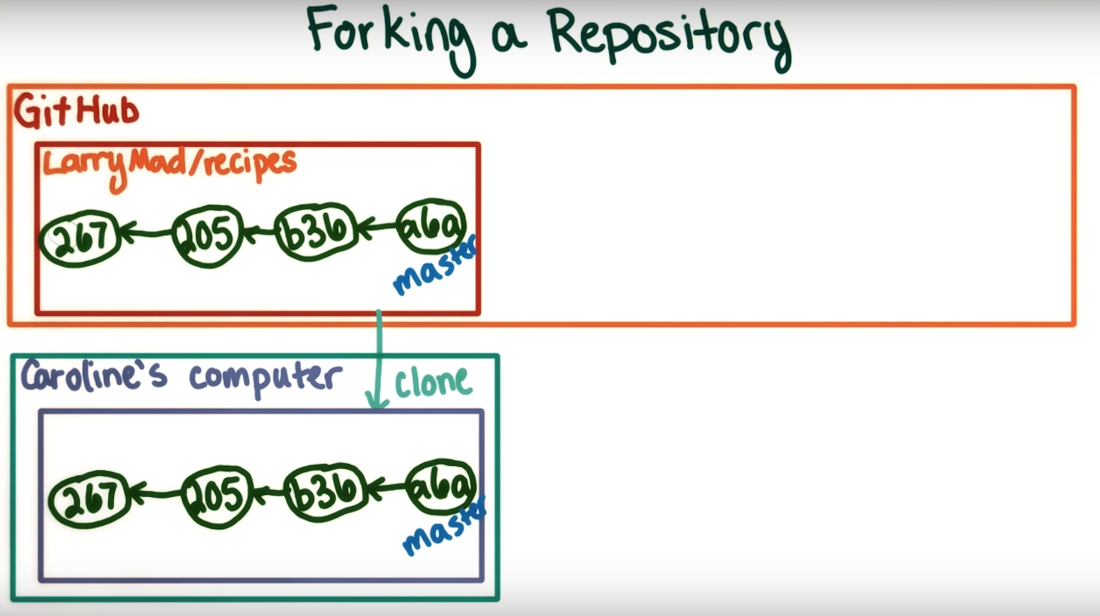
Forking Way 1
Clone Larry’s repository
to Caroline’s computer

Slide 13
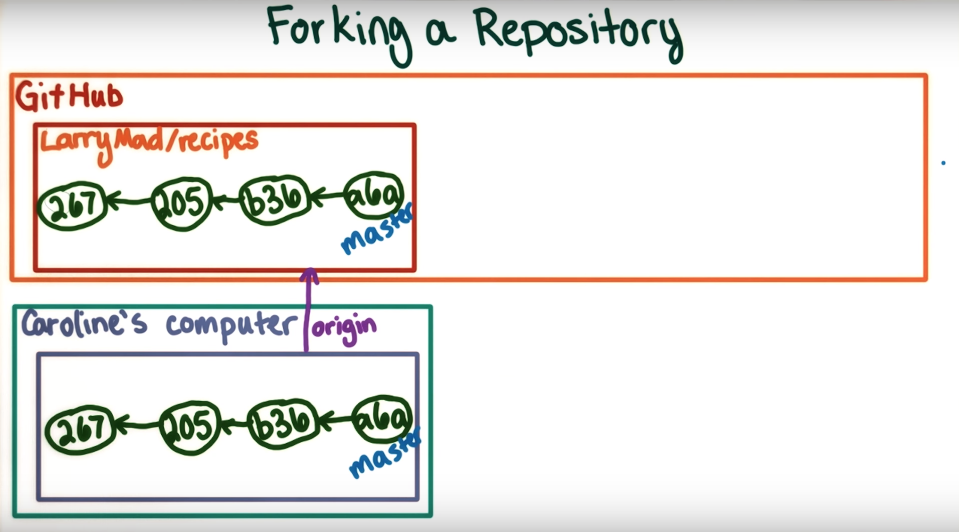
Forking Way 1
This would automatically set up Larry’s repository as a remote called Origin

Slide 14
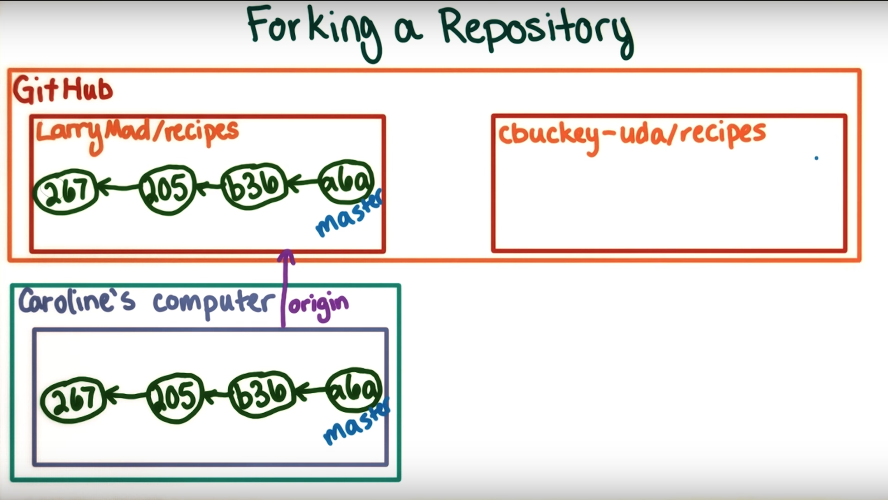
Forking Way 1
We can then create a new repository under Caroline’s
Github account

Slide 15
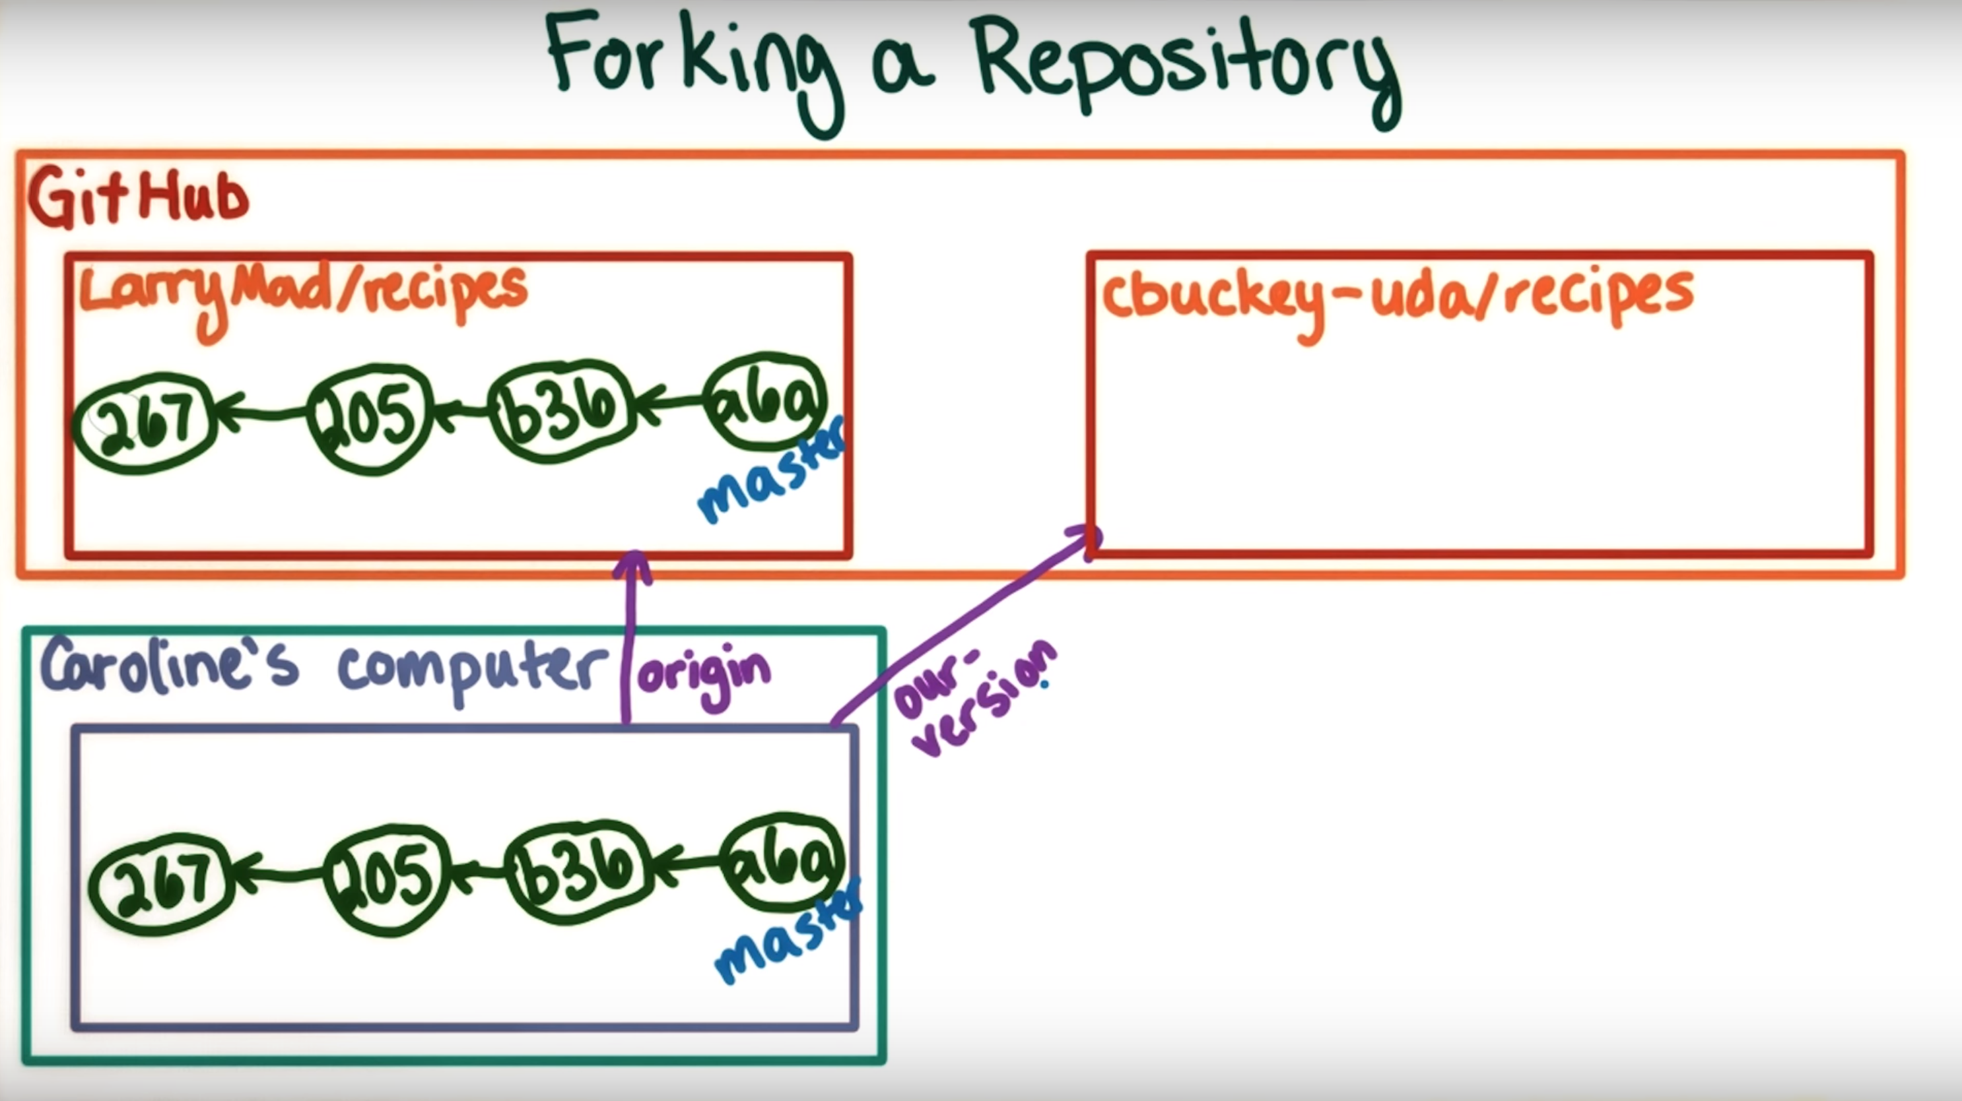
Forking Way 1
We can then setup this new repository as a remote.
called Our-Version

Slide 16
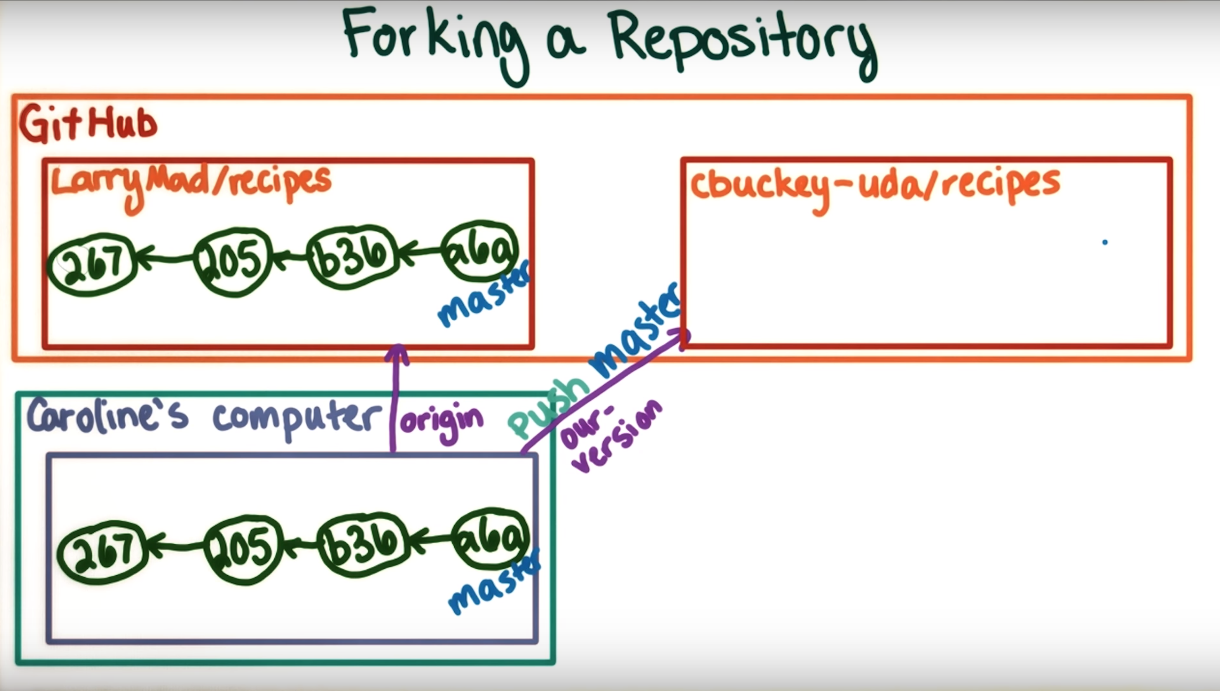
Forking Way 1
We can then push the changes to the remote
our-version

Slide 17
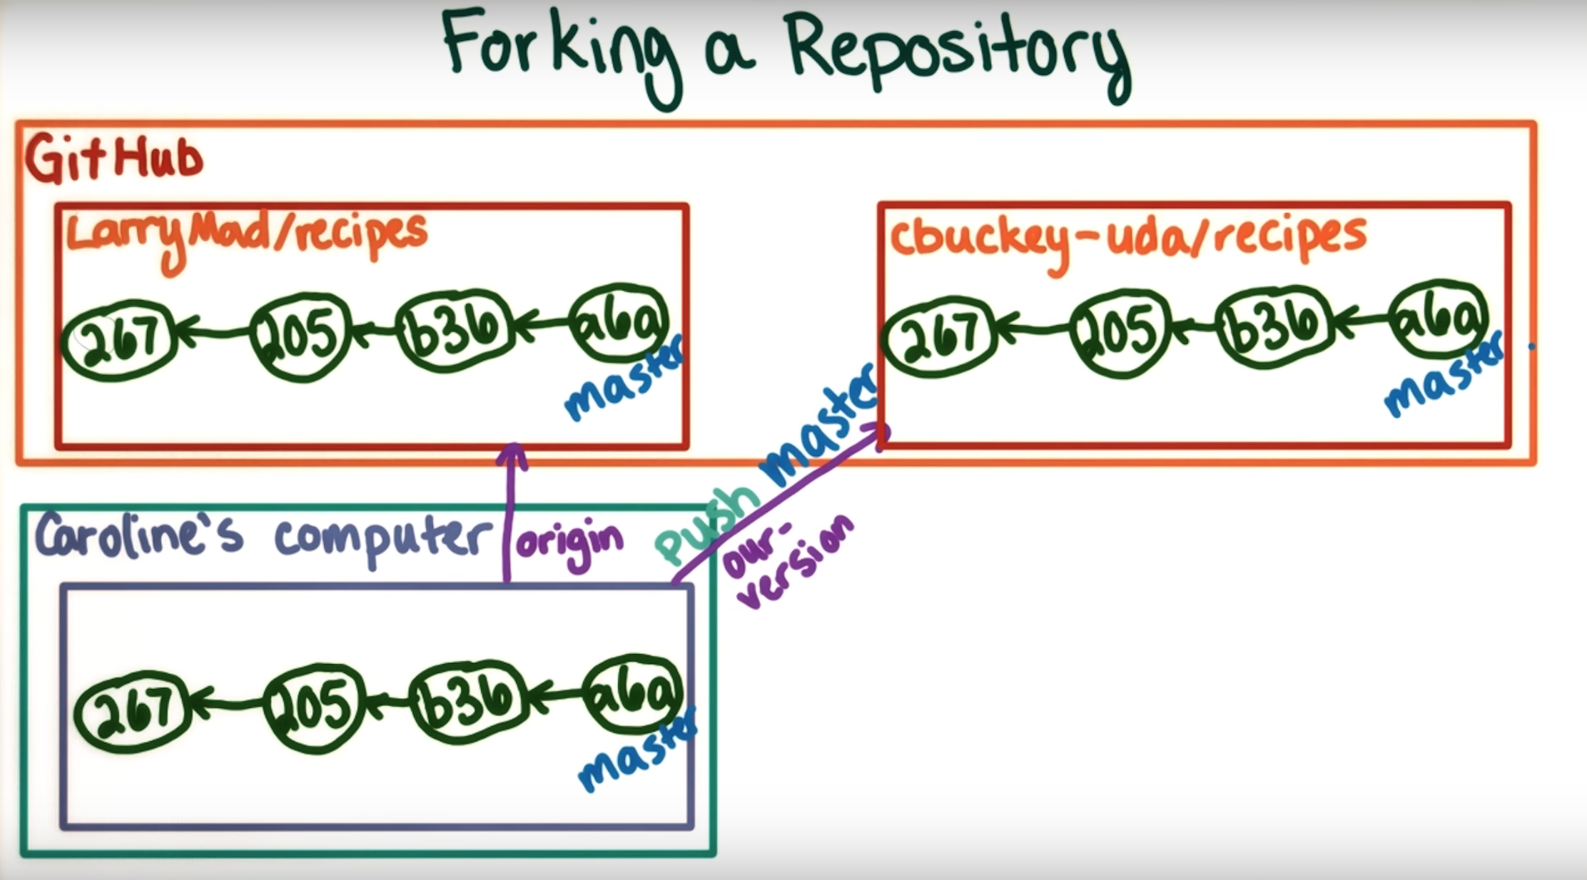
Forking Way 1

Slide 18
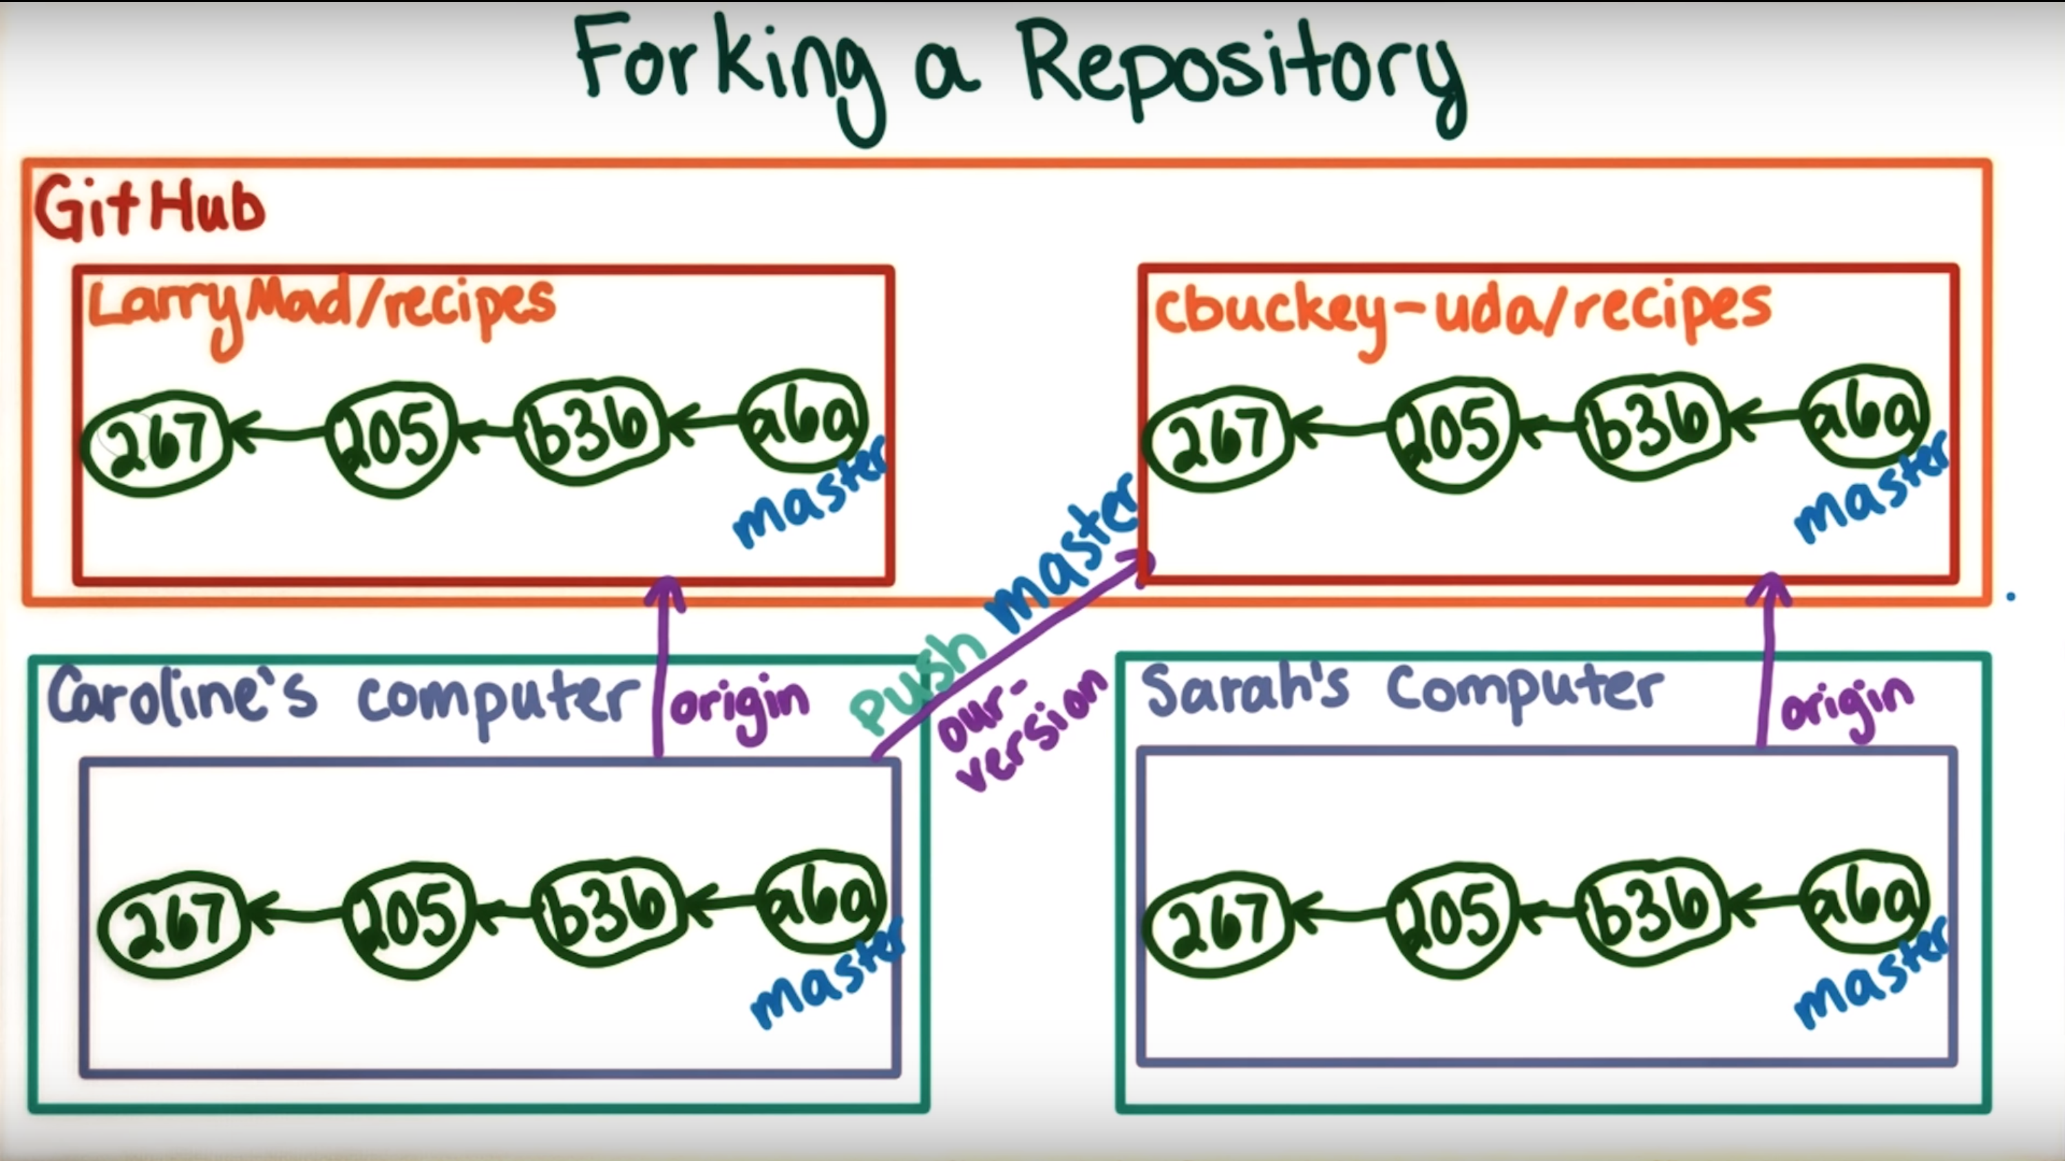
Forking Way 1
Now if Sarah wanted to
Contribute to Caroline’s repository
cbucky-uda/recipes
Sarah would clone the repository to her computer
setting up Caroline’s version as Origin

Slide 19
Downfall of Forking Way 1
This way of doing things can be a lot of work
This way also doesn’t give Larry recognition about the code he produced originally, since there is no way for someone looking at Caroline’s repository to see that Larry’s original contribution, unless we link to it explicitly.

Slide 20
Forking Way 2
Scenario:
Original Code produced by someone else
Caroline and Sarah wanting to make their own version
Less work on our behalf
Larry will get recognition for his work
Using Github’s built in Fork method
This will allow you to make a copy of someone else’s repository, directly on the Github servers without pulling the code down to your local machine first.

Slide 21
Forking Way 2
Fork an existing repository and have it appear under your own
account with just a single click

Slide 22
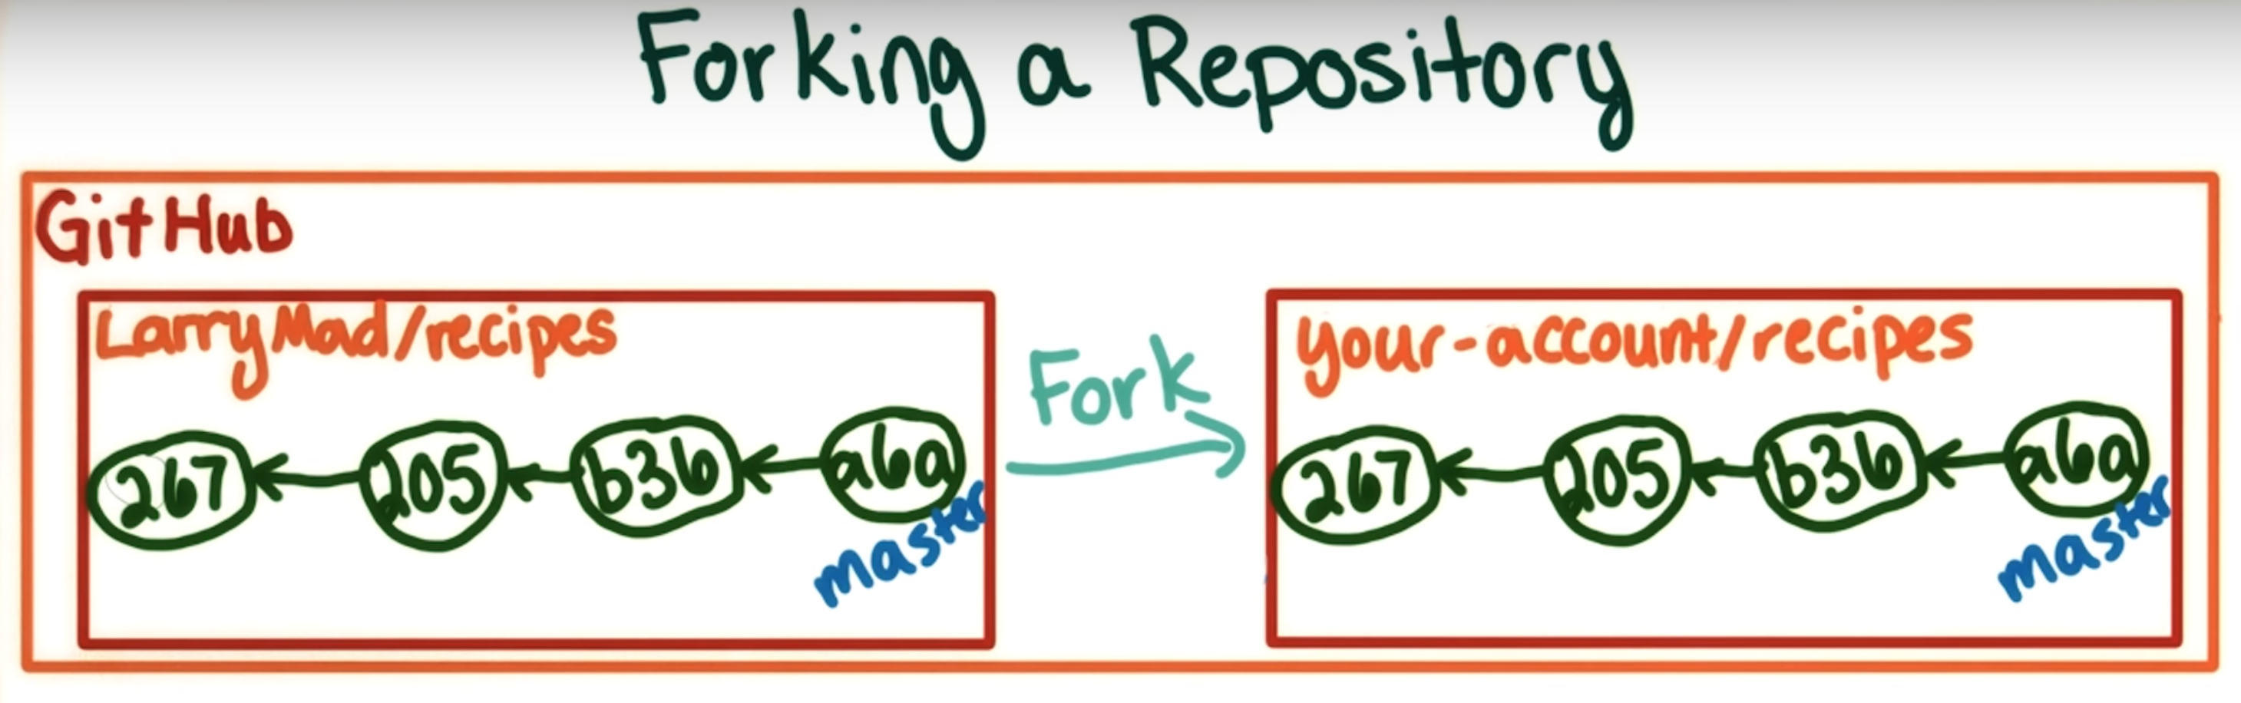
Forking Way 2

Slide 23
Forking Way 2
Then, to make modifications you would want to pull down that code to your local computer.
Forking is a clone that is done on Github’s servers.
Forking this way allows Github to:
Display a fork count of a specific repository
All the forks link back to the original.
It makes it easier to suggest changes back to the original repository

Slide 24
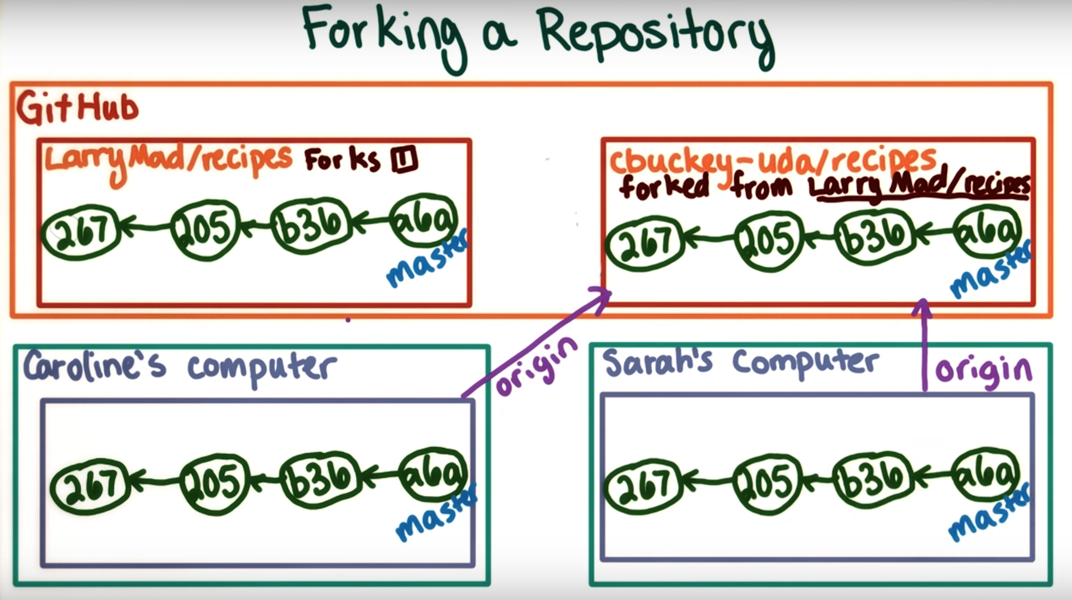
Forking Way 2
Caroline can make the fork
from her Github account.
Then both Caroline and
Sarah can each clone their
own version.
The clones don’t need to
know anything about the
original repository

Slide 25
Forking Question
Say Caroline and Sarah make changes to the original repository.
Is there a way to update Caroline’s repo when Larry’s repo has
added new content?

Slide 26
Forking
Jerry’s Recipe Repo On Github
Caroline’s Recipe Repo On Github
Caroline’s Recipe Repo Remote on Local Computer

Slide 27
Downloading the Repository
(after the first person has already made the repository)
**This should only be done once, when you are starting the project for the first time
Step 0: Make a GitHub account and download Git (and Git Bash if you want)
Step 1: Go to the page on GitHub that the repository is on
Step 2: Click the “fork” button (it should be in the upper-right). This will create a clone of the original repository on your personal GitHub account.
Step 3: Now, click on the “Clone or Download” button. Then copy the HTTPS-format URL for the repository (it should have your username in the URL, followed by the repository name).
Step 4: Then, in terminal or Git Bash, cd into whatever directory you want the project to be in.
Step 5: Now, type into the terminal: “git clone <url>” where <url> is the url that you copied
You now have the forked repo on your local machine!

Slide 28
Configuring Your Remote to Point Upstream to the Main/Original Repository
**This should only be done once, when you are starting the project for the first time
Step 1: Go to the page on GitHub that the main repository is on. This will be under the account of the owner of the repository.
Step 2: Click on “Clone or Download” and copy the HTTPS-format URL
Step 3: Go to the directory of the project in your terminal or Git Bash.
Step 4: Enter “git remote -v” to see the current remote repository for your local project. This is so you can tell if your next command works.
Step 5: Enter “git remote add upstream <url>” where <url> is the URL you copied in Step 2.
Step 6: Now if you enter “git remote -v” again, you should see another remote repository: the original repository, with the title “upstream”

Slide 29
Syncing your Fork with the Main Repository
**This should be done frequently, i.e. before creating a new branch and before committing, and maybe a few times while you’re working on your task
Step 1: Cd to your project directory / repository
Step 2: Enter “git fetch upstream”. This will fetch the commits from the main repository and bring them to your computer, in a branch titled “upstream/master”
Step 3: Switch to your local master branch with “git checkout master”.
Step 4: Merge the changes in upstream/master (the main repository) with your local repository (your own fork of the main repository) with “git merge upstream/master”.
Note:
The “merge” command merges the branch specified in the command with whatever branch you happen to be in now.
- This means that you should ALWAYS make sure you are in the right branch before you merge. - You can figure out which branch you are in with “git branch”.
You have now updated your personal fork of the repository to be up to date with the main repository!

Slide 30
Starting a Task on the Project
**This should be done each time you start a new task for the project! A.K.A. you’ll probably do this once per sprint (Agile)
Step 1: Create a new branch with the command “git branch <branch_name>”. The branch name should be something short and brief but related to the task
Step 2: Move into that new branch with the command “git checkout <branch_name>”
Step 3: Do the work! Write or fix the code, debug the code!
Note:
In your file system/IDE package explorer, only one version of the project will show up, even if you have multiple branches. This is because git stores the different branches in a compact way elsewhere, and it will only let you access the branch that you are currently on.
Show Different versions of the project using checkout

Slide 31
Uploading (Pushing) Your Work and Making a Pull Request
**This should be done whenever you have completed your task and want it reviewed and possibly added to the repository
Step 0:
Right before you stage files to commit, you need to pull from the main repository.
Doing this will make sure that you are sending up-to-date code when you make a pull request.
Don’t worry, it won’t overwrite your hard work. When you pull, it merges the repository that you are pulling from into your local files.
In addition to making sure you send up-to-date code, it will tell you if you have any merge conflicts (if there is any overlap between changes in the files). To do this, enter the command “git pull upstream master”.

Slide 32
Uploading (Pushing) Your Work and Making a Pull Request
Step 1:
Once you have done your work in a new branch, you will want to stage the files that you have changed for the commit in the future.
If your branch isn’t up to date with the main GitHub repo, you will want to make sure that you only stage the files that you yourself have edited. If you are certain that all of your files are up-to-date, then you can stage all of the files with one command.
To stage a single file: “git add <filename>”.
To stage all files “git add -A”.
To check which files have been added, type “git status”.

Slide 33
Uploading (Pushing) Your Work and Making a Pull Request
Step 2:
Now that you have the appropriate files staged (or added), you want to commit your changes (which basically saves the changes in your local Git).
“git commit -m “<message>” where “message” is a SHORT, present-tense description of what the commit does.
Examples: “Fix bugs in Entity”, “Add fight capability”, etc.
Once again, you can check the status of this with “git status”.

Slide 34
Uploading (Pushing) Your Work and Making a Pull Request
Step 3:
Now, you are going to push this branch to the repository under your account (the fork of the main repository).
Do this with “git push origin <branchname>”. This will place the current branch and all of the corresponding code on your GitHub.

Slide 35
Uploading (Pushing) Your Work and Making a Pull Request
Step 4: Go to the repository page on your GitHub account. You should see that a new branch has been created.
Step 5: Go to the branch that you just created.
Step 6: Click on “Make pull request”. It will prompt you with naming the request, and adding some comments to the request. Tell whoever is reviewing what changes you made (brief), what files they’re in, etc.

Slide 36
Uploading (Pushing) Your Work and Making a Pull Request
You’re done!
When your code has been reviewed, it will either be accepted and merged with the main master branch, or it will be denied.

Slide 37
Uploading (Pushing) Your Work and Making a Pull Request
If it is accepted, you can update your local master branch, and it’ll display the change. You can then delete your local branch where you made the changes.
If someone reviews your pull request and accepts it, then it will get merged with the master branch in the github repo,
Then you can do something like: git pull upstream master, and get the changes from the github repo and update your master branch with them.
You could merge your local branch with your local master branch if you want but the idea of pulling from upstream is to give you the most current changes, which could not only include your code, but someone else's code aswell

Slide 38
Uploading (Pushing) Your Work and Making a Pull Request
If it is denied, look at why, go back and make the edits, and then re-do these steps.

Slide 39
Resources
https://guides.github.com/
https://blog.gitprime.com/5-developer-metrics-every-software-manager-should-care-about/
https://www.youtube.com/watch?v=D2j0zebizdw
https://git-scm.com/book/en/v2/Getting-Started-About-Version-Control
https://git-scm.com/

